Slide 1

Mail登録がない会員の対応方法
Printedで始める会員の確認 Pick up members who will use printed materials.
購入するPathを事前に聞いておく
You should know which path he/she will purchase.

Slide 2

First Page of Base Camp for Printed
How to order Printed Paths
Club Officersのstart page

Slide 3

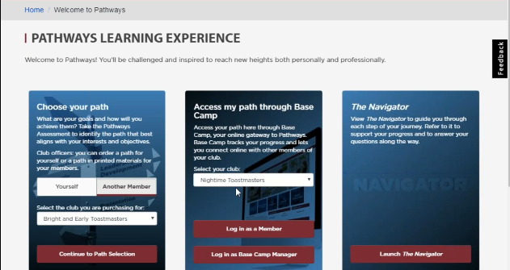
Base Camp Manager, President & Secretary
のfirst page for Another Member

Slide 4
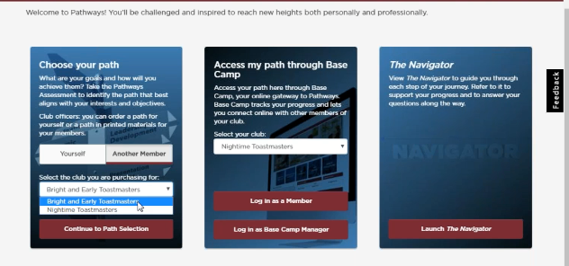
もし2つ以上のクラブに役員が所属していればどのクラブの会員のために買うかでクラブを選ぶ
Clubを選ぶ

Slide 5
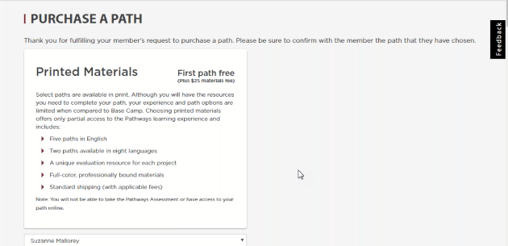
最初のpathは無料であることを確認
印刷代+郵送料=$25は必要です。

Slide 6
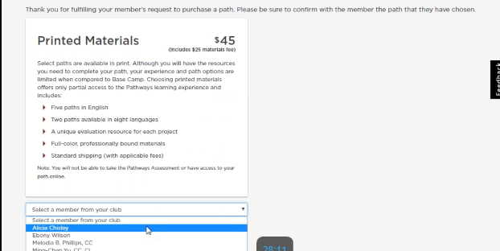

Select a member from your club
会員名を選ぶ

Slide 7

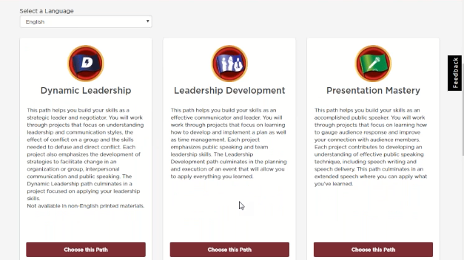
Printedで購入できるpathsだけが表示される。
言語を選ぶ

Slide 8
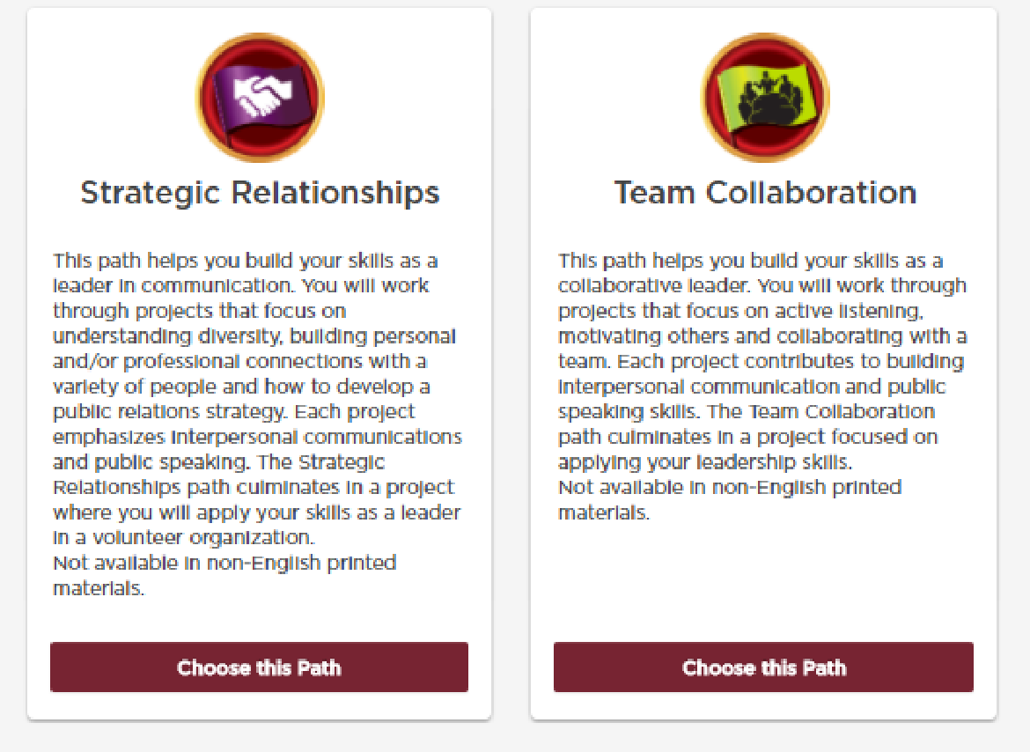

Slide 9
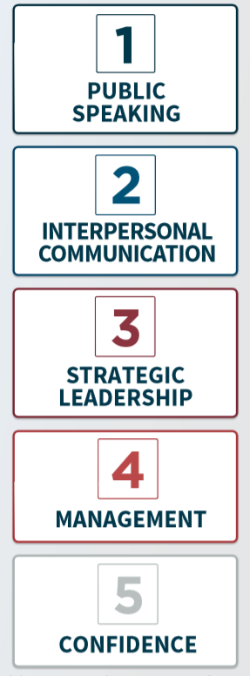
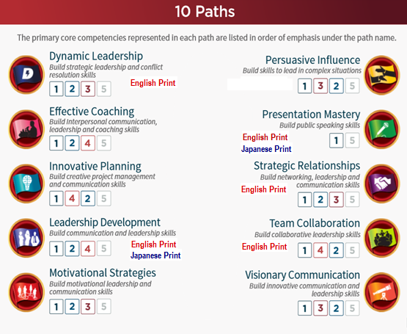
Notes:
(8) In the early stage of Pathways program development, the team identified some 100 competencies that can be learned in the current education programs. Those competencies were further divided and also additional competencies added to a total of some 300 competencies in Pathways. Those competencies were then grouped into five groups, which are called Core Competencies. Those five core competencies are ①Public Speaking, ② Interpersonal Communication, ③ Strategic Leadership, ④ Management and ⑤ Confidence. Confidence, the fifth Core Competency, is something that is acquired as a result of learning something but not confidence itself. Therefore, while being left as a Core Competency, it is not an object of learning. 10 Paths are the results of combining those core competencies by differing degrees of emphasis on each core competency.
実際のPathways開発の段階では、Toastmastersで勉強し身に付けられる各種の知識や能力を分析し、それらを５つのグループに分類しました。それらの大分類は、①Public Speaking, ②個人間コミュニケーション、③戦略的なリーダー、④マネージメント、⑤の自信です。もっとも、自信は学びの結果得られるものであり、学びの対象とはなりません。従って、これらの①から④の内の、どれに重点を置いて学ぶかを決めることにより、１０の異なったコースすなわちPathが出来上がっています。（クリック）

Slide 10
How to pay:支払い方法
When a club officer does a Pathways print-version registration on behalf of a member having no PC access, can this officer use his or her own credit card to pay $25 for this member? Or does the member have to make the payment personally?
役員のカードで？ 購入者のカードで？
For Japanese members, a payment via Credit Card is about the only practical means of international transactions to the best of my knowledge from the view point of avoiding expensive costs of currency conversion and money transfer charge by a bank. 日本人にとってはカードが最も有効な手段、振り込み等は手数料が高い。
回答: Hello Bunzo-this is at the discretion of your club. There is no specific rules for pathways payment. It would be between the club officers and the member to organize the best way that would work for them. 文三さん、Pathwaysの支払いに関しては特定のルールはありません。
代行役員と購入者でよい方法を決めてください。

